Slide 1

Adventure Escape SA
Website and mobile app design
Explore. Discover. Thrive.
Phase 2 group presentation by Rayan, Itumeleng and Asukia
Notes:
Welcome everyone. We are Rayan, Itumeleng and Asukia. Today we show the design of the Adventure Escape SA website and mobile app: why we chose the designs, the logo, the wireframes, and a demonstration.

Slide 2
The scenario we chose
Presenter: Rayan
Scenario 2: Adventure Escape SA, owned by Liam Daniels
Guided outdoor packages and individual activities
For families, teenagers, tourists, schools and corporate groups
Needs a website and a mobile app to advertise, show prices and take booking requests
4
Packages
R1 500 each
3
Individual activities
R750 each
5-15%
Discount
2 bookings 5%, 3 bookings 10%, 4+ bookings 15%
Notes:
We chose Scenario 2, Adventure Escape SA, owned by Liam Daniels. The business offers guided outdoor adventures to families, teenagers, tourists, schools and companies, and it needs a website and a mobile app to advertise and take booking requests. Customers can see activities, compare prices, build a quote and get a discount when they pick more than one.

Slide 3
Design choices and why
Presenter: Rayan
Navigation
Layout
Responsive
UI design
Simple menu: Home, About Us, Overview, Fees, Contact Us
Sticky header stays visible
Hero banner with key buttons
Same layout on every package page
Flexible grids and images
Cards stack into one column on mobile
Large, clear buttons
Orange and green for actions
Forest green
Nature, mountains, forests
Burnt orange
Excitement and action buttons
Sand beige
Calm, outdoor, Western Cape
Notes:
Four ideas guided our design. Navigation: five simple menu items so users do not have to think. Layout: the most important actions come first, like View Packages and Get Quote. Responsive design: card grids collapse to one column on phones. UI: buttons are large and consistent. Our colours are forest green for nature, burnt orange for excitement and action buttons, and sand beige for a calm outdoor feel.

Slide 4
Our logo
Presenter: Asukia
Chosen by group vote: most members found it the most professional and exciting
Forest green stands for nature, mountains and forests
Burnt orange sun and dotted trail ring show a rising or setting sun
Sand beige badge feels outdoorsy and matches Western Cape scenery
Clear even as a small app icon
Not chosen: the black and white logo (too plain) and the third logo (too simple)
Explore. Discover. Thrive.
Notes:
We voted on three logo designs and chose the second one, Rayan's design. The first, black and white mountain logo looked good but was plain and did not show adventure. The third was too simple. The second uses forest green, burnt orange and sand beige. The orange sun and the dotted trail ring around the mountain match Explore, Discover, Thrive, and the logo is simple enough to work as a small app icon.

Slide 5
Tools we used
Presenter: Itumeleng
1
Figma
2
Visual Studio Code
3
GitHub
Low-fidelity wireframes for the website and mobile app
Writing the code for the website and mobile app
Version control: store, share, track and review code
4
Google Drive / Microsoft
5
HTML, CSS, JS, React Native
Share notes, documents and research
Build, style and add interaction to the website and the mobile app
Notes:
These are the tools we used. Figma for the low fidelity wireframes of the website and the app. Visual Studio Code to write the code. GitHub for version control so everyone can review and track changes. Google Drive and Microsoft for shared notes and documents. HTML, CSS and JavaScript for the website, and React Native for the mobile app.

Slide 6
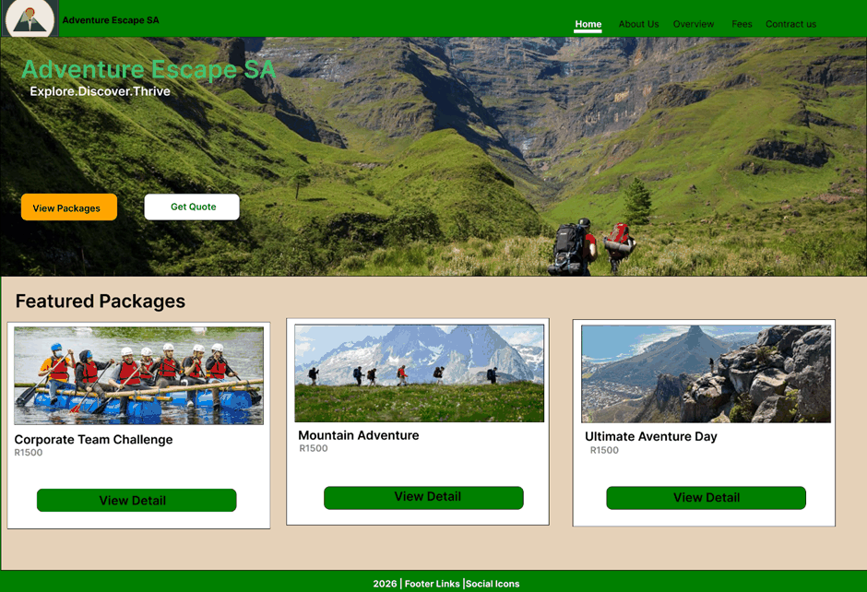
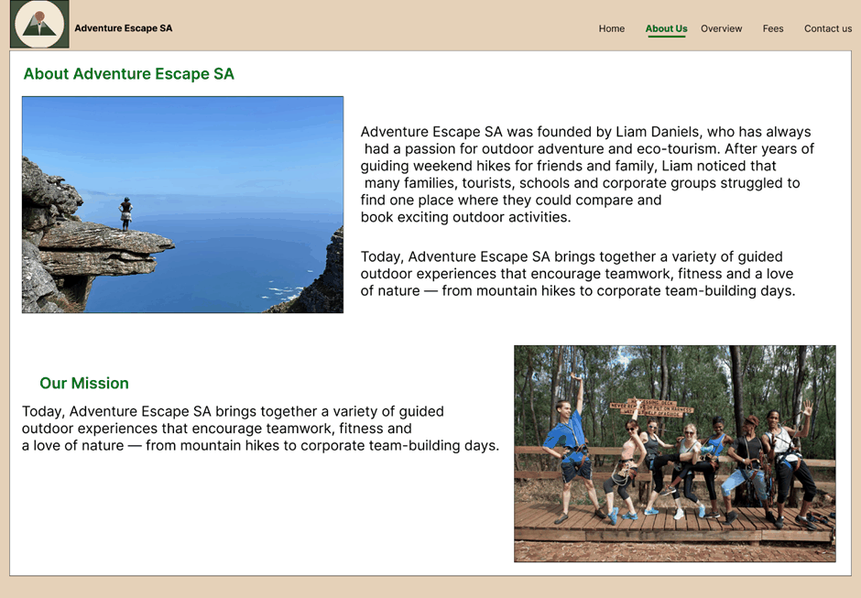
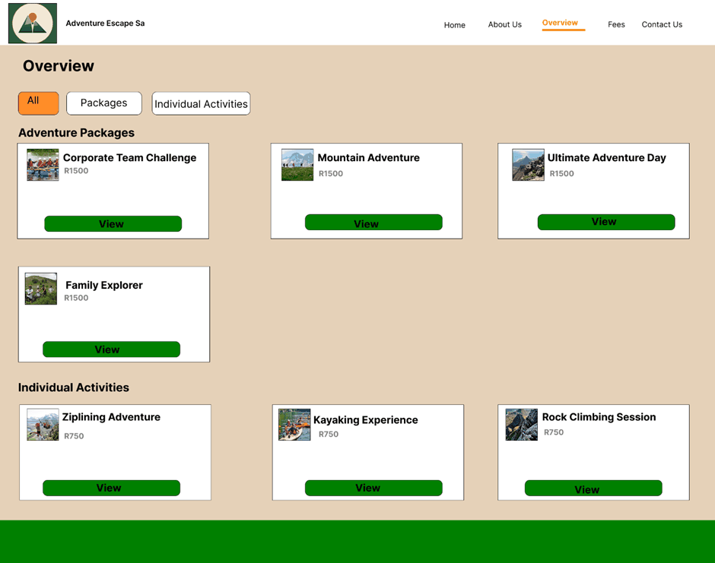
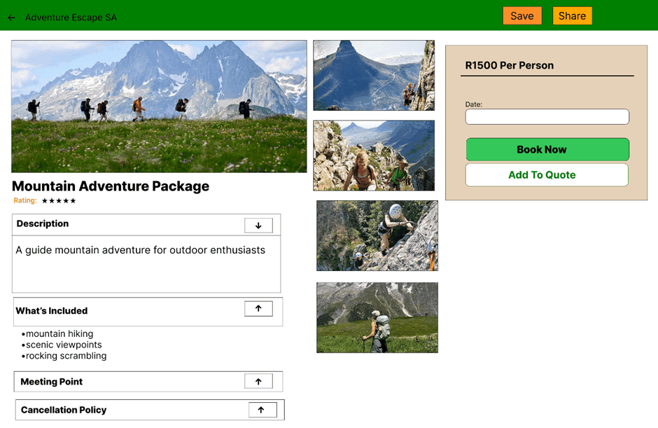
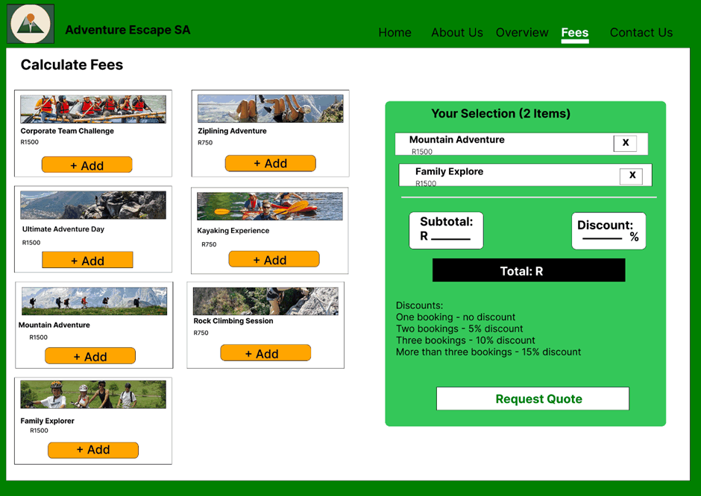
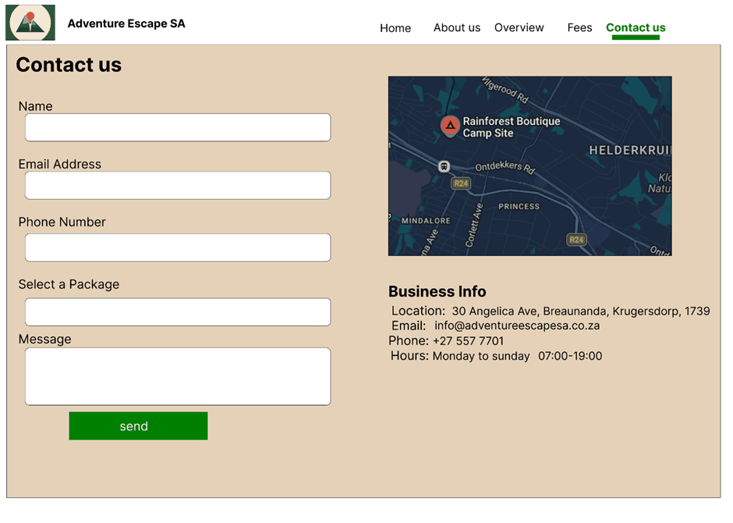
Website wireframes
Presenter: Asukia
Home
About Us
Overview
Package details
Fees
Contact
Notes:
A wireframe is a simple plan of a page before we build it. We drew six website wireframes: Home, About Us, Overview, the package details page, Fees and Contact. They show where the menu, pictures, buttons and text go, and the final website follows them.

Slide 7
Website: Home page
Presenter: Asukia
What this page does
Banner with the tagline Explore. Discover. Thrive.
Two big buttons: View Packages and Get Quote
How it works
The visitor sees the banner and the featured packages
View Packages opens the Overview page and Get Quote opens the Fees page
View Detail on Mountain Adventure opens its details page
Any picture bounces when pressed (JavaScript)
Why we designed it this way
The most important actions come first
Notes:
This is the Home page. At the top is the menu and the logo. The big banner shows the tagline and two buttons, View Packages and Get Quote, so a visitor knows what to do first. Below are the featured packages, each with a picture, the price and a View Detail button. We designed it to guide the eye to the key actions first. How it works: The visitor sees the banner and the featured packages. View Packages opens the Overview page and Get Quote opens the Fees page. View Detail on Mountain Adventure opens its details page. Any picture bounces when pressed (JavaScript).

Slide 8
Website: About Us page
Presenter: Asukia
What this page does
Tells the story of Liam Daniels, who started the company
Explains the company: guided outdoor experiences for teamwork, fitness and love of nature
How it works
The visitor reads the story of Liam Daniels and the mission
The menu at the top moves to any other page
Pictures bounce when pressed
Why we designed it this way
Builds trust with a real story and real people
Notes:
The About Us page tells customers who we are. Liam Daniels started the company because of his passion for outdoor adventure and eco-tourism. We also show our mission and photos of guests, so visitors trust us and see the experience before they book. How it works: The visitor reads the story of Liam Daniels and the mission. The menu at the top moves to any other page. Pictures bounce when pressed.

Slide 9
Website: Overview page
Presenter: Asukia
What this page does
Shows everything we offer in one place
Filter buttons: All, Packages and Individual Activities
How it works
Press Packages: only the packages show
Press Individual Activities: only the activities show
Press All: everything shows again
Press View on Mountain Adventure to open its details page
Why we designed it this way
Customers can compare options quickly
Notes:
The Overview page lists all packages and individual activities. The buttons at the top filter the list: All, Packages or Individual Activities. Each card shows a picture, the price, the rating and a View button. It lets customers compare everything on one page. How it works: Press Packages: only the packages show. Press Individual Activities: only the activities show. Press All: everything shows again. Press View on Mountain Adventure to open its details page.

Slide 10
Website: Package details page
Presenter: Asukia
What this page does
Large picture with four more pictures, title and rating
Arrows open and close Description, What's Included, Meeting Point and Cancellation Policy
How it works
Press an arrow: arrow down opens the section and shows the information, arrow up closes it
Choose a date and press Book Now: a booking message appears (it asks for a date first)
Add To Quote saves the item for the Fees page
Save downloads a screenshot, Share sends the page link
Why we designed it this way
Same layout for every package, so users know where to look
Notes:
This is the details page for the Mountain Adventure Package. The customer sees the pictures and rating, then opens each section with the arrows. On the right is the booking box with the price per person, a date, Book Now and Add To Quote. Save takes a screenshot and Share sends the page to someone. How it works: Press an arrow: arrow down opens the section and shows the information, arrow up closes it. Choose a date and press Book Now: a booking message appears (it asks for a date first). Add To Quote saves the item for the Fees page. Save downloads a screenshot, Share sends the page link.

Slide 11
Website: Fees page
Presenter: Asukia
What this page does
All packages and activities with an Add button
Your Selection box updates every time something is added or removed
How it works
Press + Add: the item goes straight into Your Selection
The subtotal, discount and total change every time
Press X to remove an item and the total updates again
Request Quote shows the quote message
Why we designed it this way
Customers see the price before they contact us
Notes:
On the Fees page the customer presses Add and the item goes straight into Your Selection. The subtotal, discount and total update every time. The discount is 5 percent for two bookings, 10 percent for three and 15 percent for more than three. The X removes an item, and Request Quote sends the quote request. How it works: Press + Add: the item goes straight into Your Selection. The subtotal, discount and total change every time. Press X to remove an item and the total updates again. Request Quote shows the quote message.

Slide 12
Website: Contact page
Presenter: Asukia
What this page does
Form: name, email, phone number, package and message
Send button shows a thank-you message with the customer's name
How it works
Fill in name, email, phone number, package and message
Press send: JavaScript checks the name and email
A thank-you message appears with the customer's name
Map and business information are shown on the right
Why we designed it this way
Easy to reach us and to ask about a package
Notes:
The Contact page has a simple form. When the customer presses send they get a thank-you message with their name. On the right are the map and our business information: the address in Krugersdorp, the email, phone number and our hours from 07:00 to 19:00, every day. How it works: Fill in name, email, phone number, package and message. Press send: JavaScript checks the name and email. A thank-you message appears with the customer's name. Map and business information are shown on the right.

Slide 13
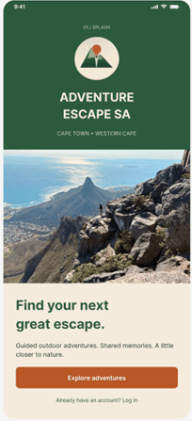
Mobile: 01 Splash
Presenter: Itumeleng
What this page does
Logo, name and Cape Town, Western Cape
Photo and the tagline Find your next great escape
Explore adventures button and a Log in link
How it works
The screen appears when the app opens
Tap Explore adventures to go to Home
Tap Log in to go to the Login screen
Why we designed it this way
A strong first impression with the brand colours
One clear button to start
Notes:
This is the Find your next great escape screen of the mobile app. Logo, name and Cape Town, Western Cape. Photo and the tagline Find your next great escape. Explore adventures button and a Log in link. How it works: The screen appears when the app opens. Tap Explore adventures to go to Home. Tap Log in to go to the Login screen. We designed it this way because: A strong first impression with the brand colours. One clear button to start.

Slide 14
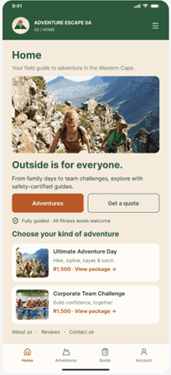
Mobile: 02 Home
Presenter: Itumeleng
What this page does
Hero photo and the message Outside is for everyone
Buttons: Adventures and Get a quote
Note: fully guided, all fitness levels welcome, and popular adventure cards with prices
How it works
Tap Adventures to browse, or Get a quote to open the Quote screen
Tap a package card to see its details
The bottom menu switches between Home, Adventures, Quote and Account
Why we designed it this way
Same main actions as the website Home page
Bottom menu: Home, Adventures, Quote, Account
Notes:
This is the Outside is for everyone screen of the mobile app. Hero photo and the message Outside is for everyone. Buttons: Adventures and Get a quote. Note: fully guided, all fitness levels welcome, and popular adventure cards with prices. How it works: Tap Adventures to browse, or Get a quote to open the Quote screen. Tap a package card to see its details. The bottom menu switches between Home, Adventures, Quote and Account. We designed it this way because: Same main actions as the website Home page. Bottom menu: Home, Adventures, Quote, Account.

Slide 15
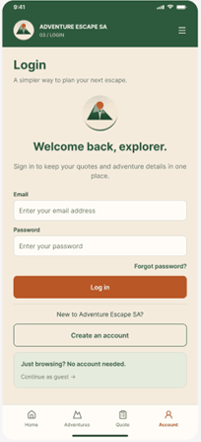
Mobile: 03 Login
Presenter: Itumeleng
What this page does
Email and password fields, Forgot password link
Log in and Create an account buttons
Continue as guest, so no account is needed
How it works
Type the email and password, then tap Log in
Forgot password? and Create an account are for returning and new users
Continue as guest skips the login
Why we designed it this way
Users can save quotes, but they are never forced to sign up
Short form with large fields for thumbs
Notes:
This is the Sign in screen of the mobile app. Email and password fields, Forgot password link. Log in and Create an account buttons. Continue as guest, so no account is needed. How it works: Type the email and password, then tap Log in. Forgot password? and Create an account are for returning and new users. Continue as guest skips the login. We designed it this way because: Users can save quotes, but they are never forced to sign up. Short form with large fields for thumbs.

Slide 16
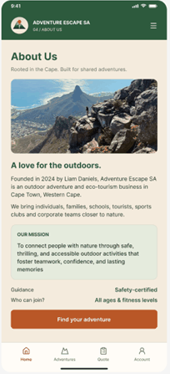
Mobile: 04 About Us
Presenter: Itumeleng
What this page does
Story of the company and Liam Daniels
Our Mission box, guidance (safety-certified) and who can join (all ages and fitness levels)
Find your adventure button
How it works
Scroll to read the story and the mission
Tap Find your adventure to go to the adventures
Why we designed it this way
Builds trust before the user books
Key facts in a small box that is easy to read
Notes:
This is the About us screen of the mobile app. Story of the company and Liam Daniels. Our Mission box, guidance (safety-certified) and who can join (all ages and fitness levels). Find your adventure button. How it works: Scroll to read the story and the mission. Tap Find your adventure to go to the adventures. We designed it this way because: Builds trust before the user books. Key facts in a small box that is easy to read.

Slide 17
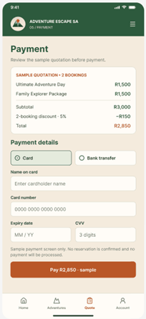
Mobile: 05 Payment
Presenter: Itumeleng
What this page does
Sample quotation for two bookings: R3 000 less 5% (R150) = R2 850
Choose Card or Bank transfer
Fields for card details and a Pay button (sample only)
How it works
Check the sample quotation and the 5% discount
Choose Card or Bank transfer
Fill in the card details and tap Pay (sample only, no real payment)
Why we designed it this way
Shows the discount clearly before paying
No real payment is taken in this demo
Notes:
This is the Payment screen of the mobile app. Sample quotation for two bookings: R3 000 less 5% (R150) = R2 850. Choose Card or Bank transfer. Fields for card details and a Pay button (sample only). How it works: Check the sample quotation and the 5% discount. Choose Card or Bank transfer. Fill in the card details and tap Pay (sample only, no real payment). We designed it this way because: Shows the discount clearly before paying. No real payment is taken in this demo.

Slide 18
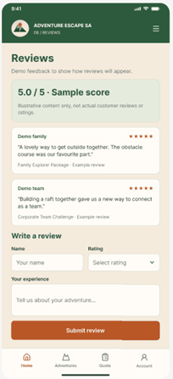
Mobile: 06 Reviews
Presenter: Itumeleng
What this page does
Sample score of 5.0 out of 5 and demo reviews
Form to write a review: name, rating and experience
Submit review button
How it works
Read the demo reviews
Enter a name, a rating and the experience
Tap Submit review
Why we designed it this way
Reviews help new customers trust the business
Marked as demo, because they are not real reviews
Notes:
This is the Reviews screen of the mobile app. Sample score of 5.0 out of 5 and demo reviews. Form to write a review: name, rating and experience. Submit review button. How it works: Read the demo reviews. Enter a name, a rating and the experience. Tap Submit review. We designed it this way because: Reviews help new customers trust the business. Marked as demo, because they are not real reviews.

Slide 19
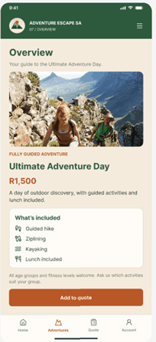
Mobile: 07 Overview
Presenter: Itumeleng
What this page does
One adventure shown in detail: Ultimate Adventure Day, R1 500
What's included: guided hike, ziplining, kayaking and lunch
Add to quote button
How it works
Scroll to see what is included
Tap Add to quote to add the adventure to the quote
Why we designed it this way
Picture first, then price and what is included
The main button stays at the bottom, easy to reach
Notes:
This is the Adventure overview screen of the mobile app. One adventure shown in detail: Ultimate Adventure Day, R1 500. What's included: guided hike, ziplining, kayaking and lunch. Add to quote button. How it works: Scroll to see what is included. Tap Add to quote to add the adventure to the quote. We designed it this way because: Picture first, then price and what is included. The main button stays at the bottom, easy to reach.

Slide 20
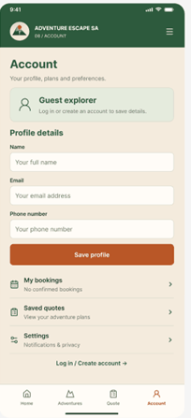
Mobile: 08 Account
Presenter: Itumeleng
What this page does
Guest explorer message and profile form (name, email, phone)
Save profile button
Links: My bookings, Saved quotes and Settings, and Log in / Create account
How it works
A guest can log in or create an account
Fill in the profile and tap Save profile
Open My bookings, Saved quotes or Settings
Why we designed it this way
All personal things in one place
Matches the Account button in the bottom menu
Notes:
This is the Account screen of the mobile app. Guest explorer message and profile form (name, email, phone). Save profile button. Links: My bookings, Saved quotes and Settings, and Log in / Create account. How it works: A guest can log in or create an account. Fill in the profile and tap Save profile. Open My bookings, Saved quotes or Settings. We designed it this way because: All personal things in one place. Matches the Account button in the bottom menu.

Slide 21
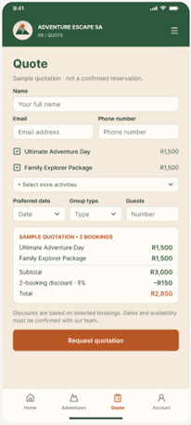
Mobile: 09 Quote
Presenter: Itumeleng
What this page does
Name, email and phone number
Selected activities with prices, preferred date, group type and number of guests
Sample quotation with discount, and Request quotation button
How it works
Fill in name, email and phone number
Tick the activities, then choose the date, group type and guests
The sample quotation shows the subtotal and the discount
Tap Request quotation
Why we designed it this way
Users can plan a group trip in one form
The discount updates with the number of bookings
Notes:
This is the Quote screen of the mobile app. Name, email and phone number. Selected activities with prices, preferred date, group type and number of guests. Sample quotation with discount, and Request quotation button. How it works: Fill in name, email and phone number. Tick the activities, then choose the date, group type and guests. The sample quotation shows the subtotal and the discount. Tap Request quotation. We designed it this way because: Users can plan a group trip in one form. The discount updates with the number of bookings.

Slide 22
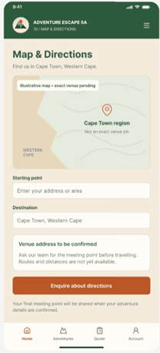
Mobile: 10 Map and Directions
Presenter: Itumeleng
What this page does
Map of the Cape Town, Western Cape area
Starting point and destination fields
Enquire about directions button
How it works
Type the starting point; the destination is Cape Town, Western Cape
Tap Enquire about directions to ask the team for help
Why we designed it this way
Helps people plan how to get to the meeting point
The exact address is confirmed by the team
Notes:
This is the Map and directions screen of the mobile app. Map of the Cape Town, Western Cape area. Starting point and destination fields. Enquire about directions button. How it works: Type the starting point; the destination is Cape Town, Western Cape. Tap Enquire about directions to ask the team for help. We designed it this way because: Helps people plan how to get to the meeting point. The exact address is confirmed by the team.

Slide 23
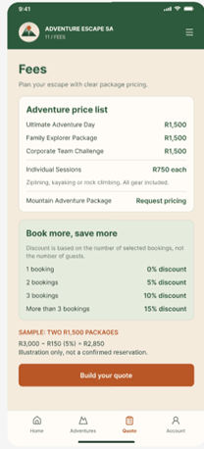
Mobile: 11 Fees
Presenter: Itumeleng
What this page does
Adventure price list: packages R1 500, individual sessions R750 each
Book more, save more: 1 booking 0%, 2 bookings 5%, 3 bookings 10%, more than 3 bookings 15%
Build your quote button
How it works
Read the price list and the discount table
Tap Build your quote to go to the Quote screen
Why we designed it this way
Clear pricing and the discount rules in one place
Same prices and rules as the website
Notes:
This is the Fees screen of the mobile app. Adventure price list: packages R1 500, individual sessions R750 each. Book more, save more: 1 booking 0%, 2 bookings 5%, 3 bookings 10%, more than 3 bookings 15%. Build your quote button. How it works: Read the price list and the discount table. Tap Build your quote to go to the Quote screen. We designed it this way because: Clear pricing and the discount rules in one place. Same prices and rules as the website.

Slide 24
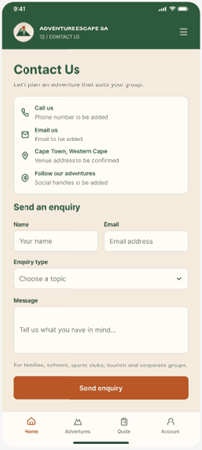
Mobile: 12 Contact Us
Presenter: Itumeleng
What this page does
Call, email, location and social media details
Send an enquiry form: name, email, enquiry type and message
Send enquiry button
How it works
Choose how to contact us: call, email or visit
Fill in the enquiry form and choose the enquiry type
Tap Send enquiry
Why we designed it this way
Several ways to reach the business
Enquiry type helps the team reply faster
Notes:
This is the Contact us screen of the mobile app. Call, email, location and social media details. Send an enquiry form: name, email, enquiry type and message. Send enquiry button. How it works: Choose how to contact us: call, email or visit. Fill in the enquiry form and choose the enquiry type. Tap Send enquiry. We designed it this way because: Several ways to reach the business. Enquiry type helps the team reply faster.

Slide 25
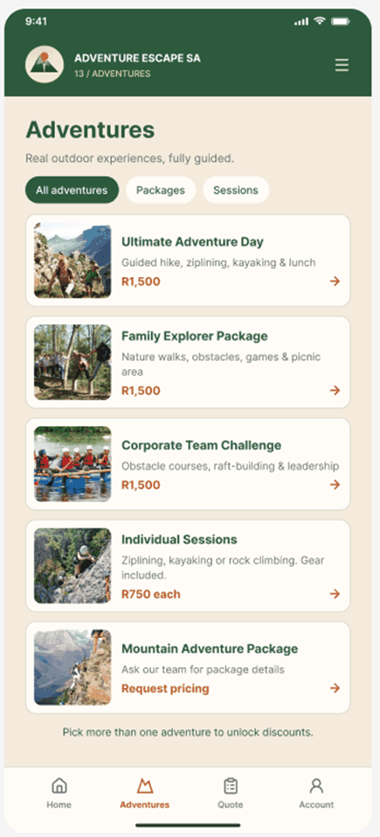
Mobile: 13 Adventures
Presenter: Itumeleng
What this page does
List of all adventures with a picture, short description and price
Filters: All adventures, Packages and Sessions
Message: pick more than one adventure to unlock discounts
How it works
Tap All adventures, Packages or Sessions to filter
Tap a card to open its Overview screen
Picking more than one adventure unlocks a discount
Why we designed it this way
Same as the website Overview page, but in one column for a phone
Tap a card to open the adventure
Notes:
This is the Adventures screen of the mobile app. List of all adventures with a picture, short description and price. Filters: All adventures, Packages and Sessions. Message: pick more than one adventure to unlock discounts. How it works: Tap All adventures, Packages or Sessions to filter. Tap a card to open its Overview screen. Picking more than one adventure unlocks a discount. We designed it this way because: Same as the website Overview page, but in one column for a phone. Tap a card to open the adventure.

Slide 26
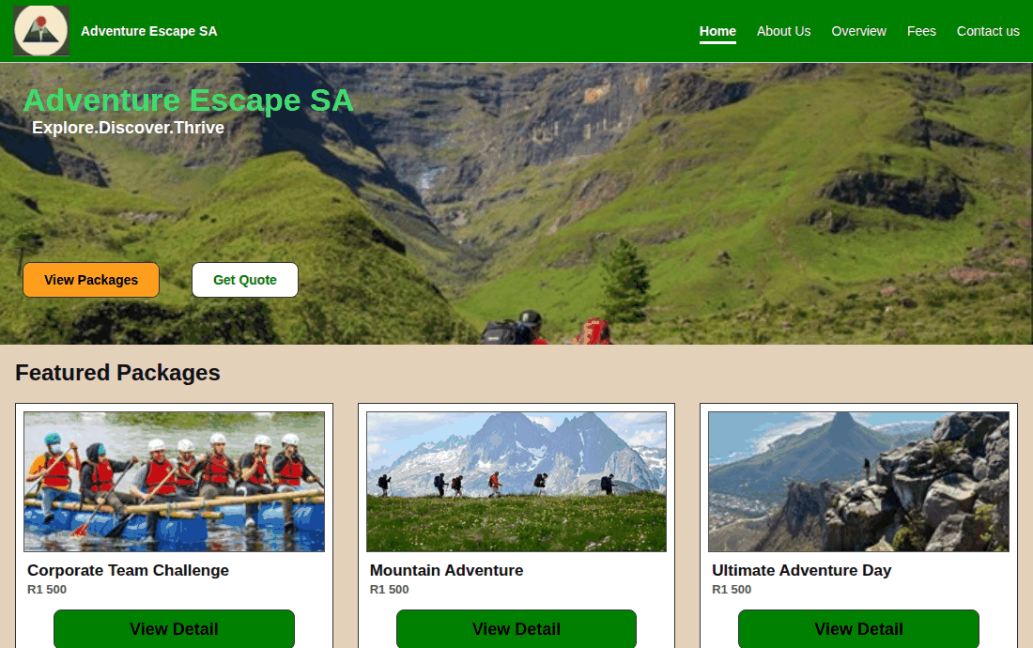
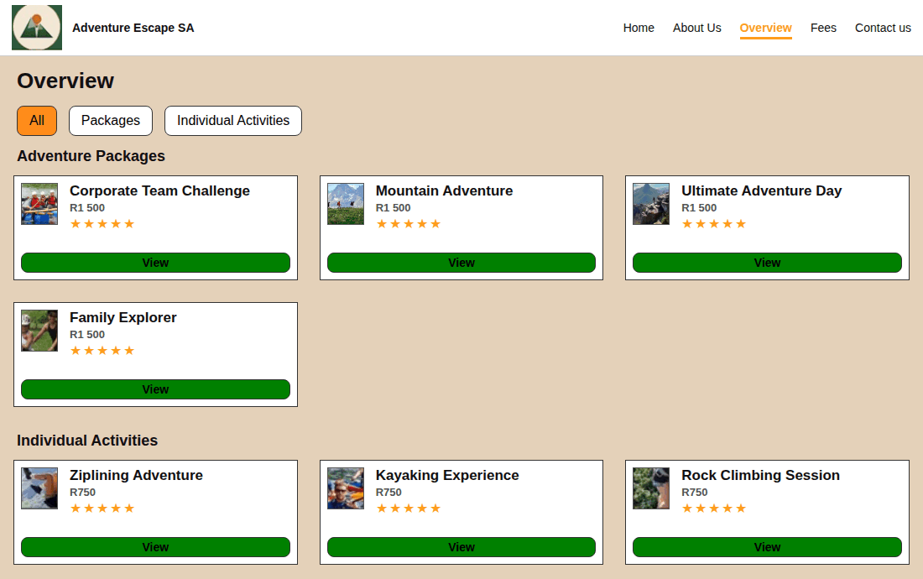
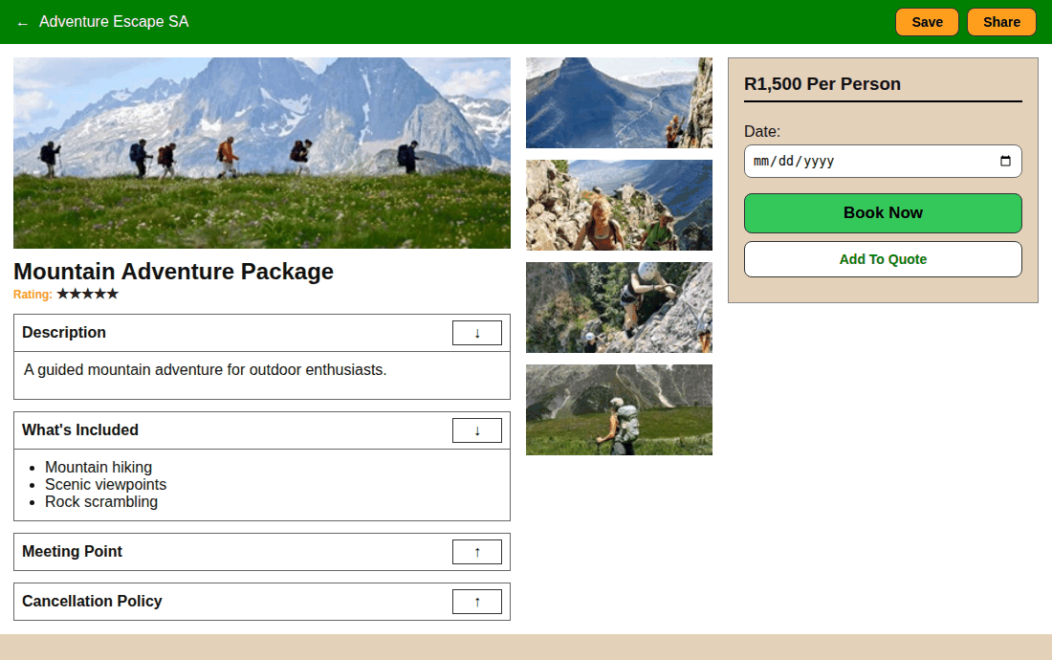
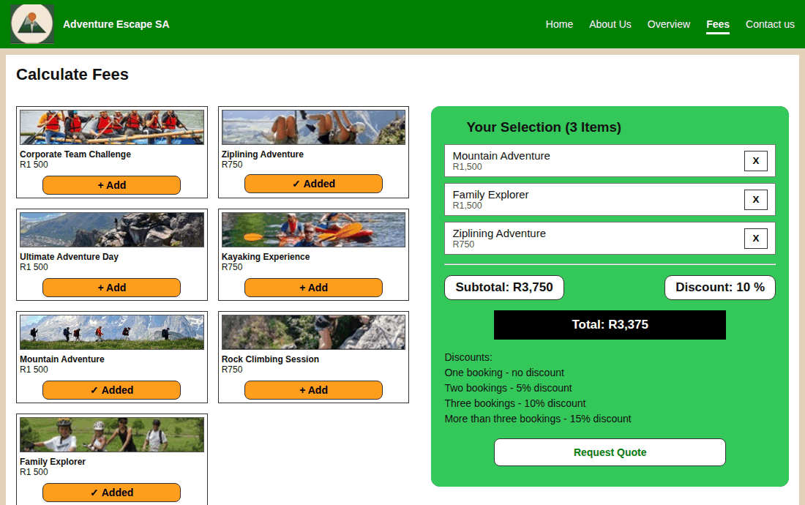
Website demonstration
Presenter: Rayan
Home: Featured packages
Overview: Filters and ratings
Package details: Arrows, date, Book Now
Fees: Add items, discount and total
Notes:
Live demonstration: show the Home page, then the Overview page and its filters, then the Mountain Adventure details page with the arrows, date, Book Now and Add To Quote, then the Fees page where we add items and watch the subtotal, discount and total change, and finally the Contact page.

Slide 27
Mobile app demonstration
Presenter: Itumeleng
Splash
>
Home
>
Adventures
>
Overview
>
Quote
>
Payment
Choose adventures and add them to a quote
Discount is worked out from the number of bookings: 2 bookings 5%, 3 bookings 10%, more than 3 bookings 15%
Example: two R1 500 packages = R3 000, minus R150 (5%) = R2 850
Sample payment, reviews, map and directions, and account screens are also included
Notes:
Walk through the app in this order. Splash screen, then Home, then Adventures, then pick one adventure on the Overview screen and add it to the quote. The Quote screen shows the subtotal and the discount, for example two packages of R1 500 become R2 850 after 5 percent. Finally we show the sample Payment screen, Reviews, Map and Directions, and Account.

Slide 28
Our team
R
Rayan
I
Itumeleng
A
Asukia
Researched the scenario
Decided on the best design
Wrote and managed the project documents
Notes and group decisions
Researched navigation, layout, responsive and UI design
Built 6 mobile wireframes, chose the tools
Researched website and app design ideas
Logo design and colour palette
Built 6 website wireframes, managed the Figma link
Notes:
Each member had their own tasks. Rayan researched the scenario, chose the best design and managed the project documents. Itumeleng took notes, researched navigation, layout, responsive and UI design, built the six mobile wireframes and chose the infrastructure. Asukia researched design ideas, provided the logo and colour palette, built the six website wireframes and managed the Figma link.

Slide 29
Thank you
Questions?
Adventure Escape SA: Explore. Discover. Thrive.
Notes:
Thank you for watching and listening. We are happy to answer any questions about the website and mobile app designs.

